Slide 1


Unit- 5
Deep Learning

Slide 2
Chapters for Discussion
Chapter- 1
Introduction to DL
Chapter- 2
Neural Networks

Slide 3

Unit
Deep Learning
5

Slide 4


DISCLAIMER
The content is curated from online/offline resources and used for educational purpose only.

Slide 5

Learning Objectives
Identify and describe the roles of neurons as the basic units of a neural network.
Differentiate between input, hidden, and output layers and explain their purposes in a neural network.
Define activation functions and explain their importance in introducing non-linearity to neural networks.
Explain the concept of a loss function and its role in assessing the performance of a neural network.
Define optimization algorithms and their importance in updating neural network weights to minimize loss.
Evaluate the impact of various choices (e.g., activation functions, loss functions, optimization methods) on network performance.
GOAL
Source :
www.freepik.com/

Slide 6
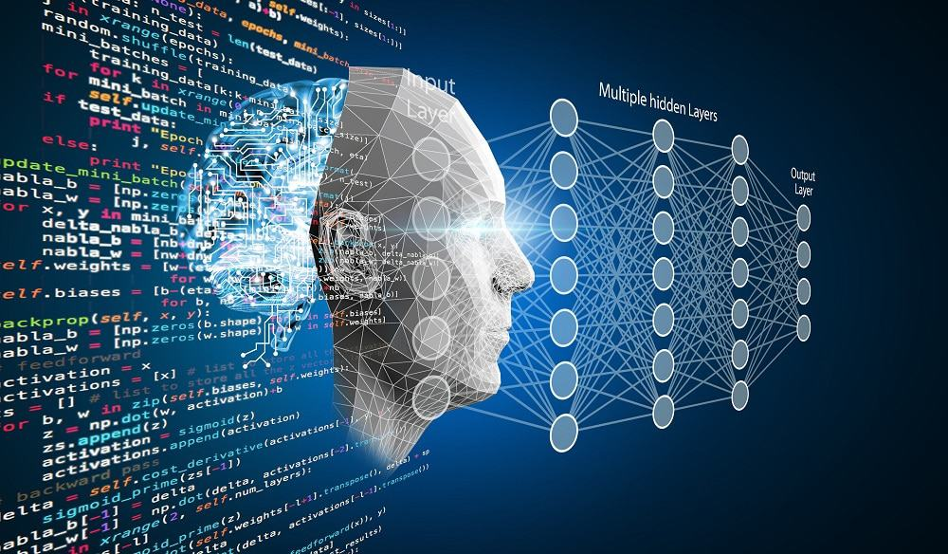
Introduction to Deep Learning
Deep learning, a subfield of AI, uses neural networks inspired by the human brain to process large data.
It excels in tasks like image recognition, natural language processing, and reinforcement learning, achieving state-of-the-art results.
Source :
https://www.ileafsolutions.com/demystifying-deep-learning-a-beginners-guide
Notes:
The world of artificial intelligence is advancing very rapidly. What was once deemed impossible is now in the pipeline as top technology that would change the behavior of machines while processing, learning from, or making interactions with complex data. Deep learning essentially mimics the complex neural networks of the human brain, and it allows computers to independently recognize patterns and gain insights from vast amounts of unstructured data. The field is transformative, with impressive breakthroughs in almost all areas: computer vision, natural language processing, diagnostics in healthcare, and self-driving cars.
Deep learning is a transformative field within artificial intelligence (AI) that has revolutionized our ability to process and understand data. By leveraging powerful computational frameworks and layered neural networks, deep learning enables machines to learn and perform tasks that previously required human intelligence. In this section, we will explore the foundations, historical journey, significance, and applications of deep learning.

Slide 7
What is Deep Learning?
Artificial Neural Networks: Deep learning algorithms are inspired by the structure and functioning of the human brain.
Pattern Discovery: Deep learning uses networks with multiple hidden layers to automatically discover patterns in complex data sets.
Important Characteristics:
Layered Structure
Neural networks are composed of an input layer, multiple hidden layers, and an output layer.
Automated Feature Extraction
Deep learning automatically learns representations directly from raw data, minimizing human intervention.
Source :
https://becominghuman.ai/building-an-image-classifier-using-deep-learning-in-python-totally-from-a-beginners-perspective-be8dbaf22dd8
Notes:
What is Deep Learning?
Deep learning is the new trend in machine learning that focuses on algorithms inspired by the structure and functioning of the human brain - artificial neural networks. It includes various techniques of using networks with multiple hidden layers (thus the term "deep") to auto-discover patterns in massive and complex data sets.
Important Characteristics
Layered Structure: In deep learning, neural networks are composed of an input layer, multiple hidden layers, and an output layer. Each layer processes information and passes it to another layer for hierarchical feature extraction.
Example: Image recognition, edges detected in the first layer; texture and shape are identified by later layers and entire objects, such as a face or a car, by even later layers.
Automated Feature Extraction: Unlike machine learning, deep learning assumes that there is no human hand selecting and engineering, assuming representations automatically learnt directly from raw data.

Slide 8
Historical Background
Early Foundations
The first mathematical model of a neuron was proposed in 1943.
The AI Winter
Limited computing power and datasets led to a decline in interest in neural networks in the late 20th century.
Resurgence of Deep Learning
Advances in GPUs, massive datasets, and new ideas sparked renewed interest in deep learning in the 2000s.
Notes:
Deep learning has an interesting history in being closely related to early research into artificial intelligence and computational models of the brain. Its journey could be marked by outstanding moments:
Early Foundations
1943: Warren McCulloch and Walter Pitts proposed the first mathematical model of a neuron.
1950s-1980s: Simple neural networks such as the Perceptron preceded this but failed in its limitations, such as not being able to solve non-linear problems.
The AI Winter
With limited computing power and no large datasets, theory further depressed interest in neural networks through the late 20th century.
Resurgence of Deep Learning
2006: Interest was sparked by the idea of deep belief networks by Geoffrey Hinton, et al .
Advances in GPUs, massive datasets (ImageNet), etc. and ideas like ReLU activation and dropout regularization had made deep learning practical and powerful enough.

Slide 9
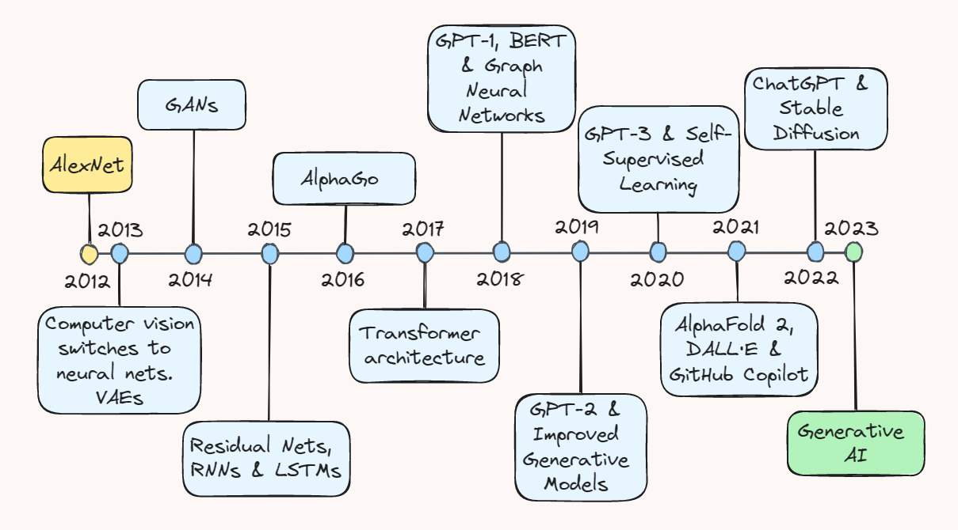
Timeline of last decade
Source :
https://towardsdatascience.com/ten-years-of-ai-in-review-85decdb2a540
Notes:
Key milestones :
2012:
"Computer vision switches to neural nets. VAEs" marks a pivotal shift in computer vision using neural networks and the introduction of Variational Autoencoders (VAEs).
2013:
"AlexNet" is introduced, revolutionizing image recognition by leveraging deep convolutional neural networks.
2014:
"GANs" (Generative Adversarial Networks) are developed, enabling AI to generate realistic images, videos, and data.
2015:
Advances in "Residual Nets, RNNs & LSTMs" (Recurrent Neural Networks and Long Short-Term Memory networks) improved sequential and time-series processing.
2016:
"AlphaGo" demonstrates AI's ability to surpass human performance in complex board games like Go.
2017:
"Transformer architecture" is introduced, significantly impacting natural language processing and AI model efficiency.
2018:
Milestones include "GPT-1, BERT & Graph Neural Networks," laying the groundwork for powerful language models and graph-based learning.
2019:
"GPT-2 & Improved Generative Models" highlight advancements in text generation and AI creativity.
2020:
"GPT-3 & Self-Supervised Learning" mark a leap in AI capabilities with more sophisticated language understanding and generation.
2021:
"AlphaFold 2, DALL·E & GitHub Copilot" showcase breakthroughs in protein structure prediction, generative image models, and AI-assisted coding.
2022:
Major highlights include "ChatGPT & Stable Diffusion," which popularized conversational AI and high-quality image generation.
2023:
The evolution of "Generative AI" consolidates advancements, emphasizing its integration into diverse fields.

Slide 10
Why Deep Learning?
High Accuracy
Deep learning achieves state-of-the-art performance in complex tasks, such as image recognition.
Versatility
Deep learning is applicable across various domains, including natural language processing, healthcare, and self-driving cars.
Automation
Deep learning automates feature learning, minimizing human intervention.
Notes:
Deep learning has become indispensable for solving some of the most complex and dynamic problems in modern technology.
Key Advantages
High Accuracy in Complex Tasks:
Example: Deep learning achieves state-of-the-art performance in image recognition tasks, outperforming traditional machine learning methods.
Versatility:
It crosses paradigms: from natural language processing, where one gets chatbots based on GPT, to healthcare diagnostics, like cancer detection.
Automation:
It automatically learns features, minimizing human intervention.
Real-World Applications
Image Recognition Applied in photo tagging, facial recognition, and object detection for autonomous driving systems.
Speech Recognition Enables virtual assistants, such as Alexa and Siri.
Games: Deep learning reinforcement led to innovations like AlphaGo.
Natural Language Processing (NLP): Drives translation services, sentiment analysis, and chatbots.

Slide 11
Neurons and Layers
1
Neurons The basic building blocks of neural networks, responsible for processing and transforming data.
2
Layers Groups of neurons that work together to process data and extract patterns.
3
Activation Functions Introduce non-linearity to the model, enabling it to learn complex relationships.
Notes:
1. Neurons
Neurons are the fundamental units of a neural network, inspired by the biological neurons in the human brain. Each neuron receives input signals (data or outputs from other neurons), processes them by applying a set of weights and biases, and produces an output. This output is passed through an activation function, which determines whether and how the neuron "fires" or activates. Neurons are responsible for extracting and processing features from the input data at each stage of the network.
For example:
In a neural network for image recognition, neurons in the first layer might identify simple edges, while neurons in deeper layers learn more complex features like shapes or objects.
2. Layers
Layers are structured groups of neurons that work collectively to analyze and transform input data. They form the architecture of a neural network.
3. Activation Functions
Activation functions introduce non-linearity into a neural network, making it capable of learning and modeling complex relationships in the data. Without them, the model would behave like a simple linear system, severely limiting its ability to solve real-world problems. Activation functions decide how strongly a neuron responds to its inputs by transforming the neuron's weighted sum of inputs into a specific range.

Slide 12
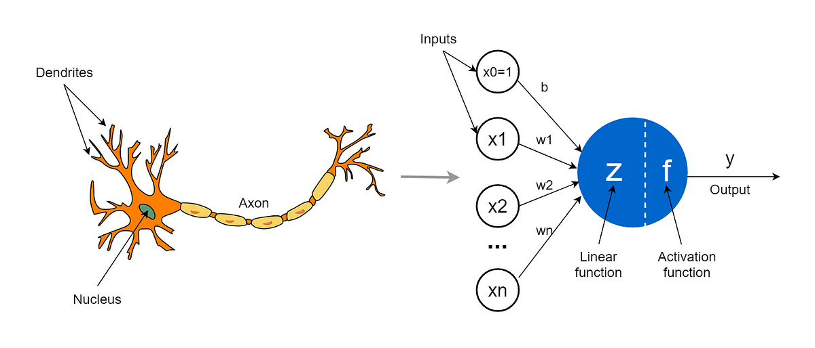
What's a Neuron?
Inputs | Data points or features fed into the neuron.
Weights | Determine the importance of each input.
Bias | Fine-tunes the neuron's output.
Activation Function | Introduces non-linearity to the model
Source :
https://towardsdatascience.com/the-concept-of-artificial-neurons-perceptrons-in-neural-networks-fab22249cbfc
Notes:
What's a Neuron?
The smallest computation unit in a neural network is the neuron at its center. This kind of neuron mimics its biological counterparts found in the human brain, which perform the simple yet crucial function of receiving input data, processing using mathematical operations, and producing output. This output forms an input to further neurons in the network, thereby allowing information flow and transformation.
Neuron Structure
One neuron can be viewed as a mathematical function that takes inputs, weights their importance, adds a bias term to introduce flexibility, and feeds this result through an activation function that introduces nonlinearity into the model. With this kind of neuron, it can model complex relationships that reside in the data.
Components of a Neuron
Inputs $(x_{1},x_{2},…,x_{n} ​)$: These are the data points or features fed into the neuron. In a simple dataset, inputs could represent variables such as age, income, or temperature.
Weights $(w_{1},w_{2},…,w_{n} ​)$: Each input is multiplied by a corresponding weight. The weight determines the importance or contribution of each input to the final output. During training, the network adjusts these weights to improve predictions.
Bias (b): The bias is an additional parameter that helps the neuron fine-tune its output. It shifts the activation function, allowing the network to better fit the data.
Equation: The computation performed by a single neuron can be summarized mathematically as:
$$z = w_{1}⋅x_{1} +w_{2}⋅x_{2}+… +w_{n}⋅x_{n} + b$$
Here, z represents the intermediate result before applying the activation function.
Activation Function: The result z is passed through an activation function, which transforms it into the neuron's output, introducing the non-linearity necessary for learning complex patterns.
Example to Understand:
To understand the how neuron works, Imagine a scenario where we want to predict the price of a house based on three features: the number of bedrooms $(x_{1​})$, the square footage $(x_{2})$, and the distance to the city center $(x_{3}​)$. For example, suppose a house has 3 bedrooms $(x_{1}=3)$, 1500 square feet $(x_{2}=1500)$, and is located 10 miles from the city center $(x_{3}=10)$. These inputs are processed by a neuron to predict the house price.
Each input is associated with a weight that represents its relative importance in determining the house price. For instance, let the weight for the number of bedrooms be $w_{1}=5000$ (indicating that each additional bedroom increases the price by $5000), the weight for square footage be $w_{2}=200$ (meaning the price increases by $200 for each additional square foot), and the weight for distance from the city center be $w_{3}=−1000$ (suggesting the price decreases by $1000 for each additional mile away from the city). Additionally, a bias (b) is added to fine-tune the prediction, such as $b=10000$, which serves as a baseline adjustment for the price.
The neuron computes the weighted sum of the inputs and the bias using the equation:
$$z = w_{1}⋅x_{1}+w_{2}⋅x_{2}+w_{3}⋅x_{3}+ b$$
Substituting the values, the computation becomes:
$$z= (5000⋅ 3) + (200⋅ 1500) + (−1000⋅ 10) + 10000 = 305000$$
The result (z = 305000) is then passed through an activation function, such as the Rectified Linear Unit (ReLU), which outputs the maximum of 0 and z. Since z=305000 is positive, the ReLU function outputs 305000, representing the predicted house price.

Slide 13
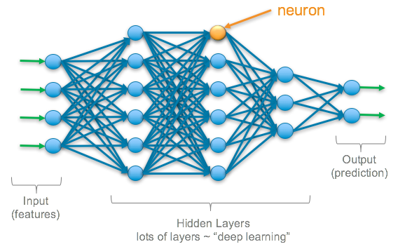
Layers in a Neural Network
Input Layer
Receives raw data and passes it to subsequent layers.
Hidden Layers
Process data and extract patterns, relationships, or hierarchies.
Output Layer
Produces the network's prediction based on the processed data
Source :
https://srnghn.medium.com/deep-learning-overview-of-neurons-and-activation-functions-1d98286cf1e4
Notes:
Layers in a Neural Network
A neural network is essentially a kind of computational system based on the structure and function of the human brain. Neurons are its core building blocks, which are grouped into layers. These layers work in sequence to process data and extract meaningful patterns.
Input Layer
The input layer is where the network connects to raw data. It takes input features directly and passes them along to other layers; that's what makes each neuron in the input layer represent a feature of the dataset:
For image datasets, the input neurons ought to be representing pixel intensities.
For tabular data, they are to represent single features, like age, or income, or temperature.
The input layer does not do any computations—it only transmits the unprocessed input to the next layer for processing.
Hidden Layers
The hidden layers are the meat of a neural network. These layers process the input data based on mathematical operations intended to uncover patterns, relationships, or hierarchies in the data. Key features of hidden layers are as follows:
Connections: All the neurons in a hidden layer are connected to both the previous and subsequent layers through weighted edges.
Weights and Biases: Each connection has a weight that decides its influence, and each neuron has a bias that shifts its activation threshold.
Activation Functions: This captures non-linear relationships in the data by using specific activation functions on the output from each neuron, such as ReLU (Rectified Linear Unit), sigmoid, or tanh.
Depth and Abstraction: The more layers that a network contains in hidden layers, the deeper neural networks, which are capable of learning increasingly abstract representations of the data. For example:
Early layers may detect edges in an image
Intermediate layers may identify shapes or textures.
Some of the layers later on can recognize pretty complex objects such as a face or a vehicle.
Output Layer
The final output layer is responsible for the network producing what it wants depending on the problem. Depending on what kind of problem, the output layer differs in structure and behavior:
Binary Classification: The single neuron in this layer uses sigmoid activation and outputs a probability score corresponding to class membership.
Multi-class Classification: Several neurons with the softmax activation function output probabilities for each class.
Regression Tasks: One neuron with a linear activation function output a continuous value.
The output layer makes sure the predictions coming from the network are in line with the problem domain.

Slide 14

Lab Activity
Hands On
Lab 1
Implementing a simple neural network

Slide 15

Conclusion
Neural networks rely on neurons as their fundamental units, working across input, hidden, and output layers to process and generate predictions.
Activation functions introduce non-linearity, enabling complex modeling, while loss functions measure performance, and optimization algorithms adjust weights to minimize errors.
Key design choices, such as activation functions, loss functions, and optimization methods, critically impact network performance, making them essential to creating effective models.
Source :
www.freepik.com/

Slide 16
References
https://artemoppermann.com/activation-functions-in-deep-learning-sigmoid-tanh-relu/
https://towardsdatascience.com/activation-functions-neural-networks-1cbd9f8d91d6
https://taylorandfrancis.com/knowledge/Medicine_and_healthcare/Neurology/Artificial_neural_networks/
https://en.wikipedia.org/wiki/Neural_net
https://www.ibm.com/think/topics/loss-function

Slide 17


Let’s Start

Slide 18


Quiz
What does a neuron in a neural network represent?
a) A single layer in the network.
b) A mathematical function performing computations like weighted sums and activation.
c) A manual feature engineering component.
d) A unit that only stores input data.
Answer: B
A mathematical function performing computations like weighted sums and activation.

Slide 19
Quiz
What is the primary role of weights in a neuron?
a) To determine the importance of each input.
b) To eliminate biases in predictions.
c) To serve as the activation function.
d) To store the final outputs.
Answer: A
To determine the importance of each input.

Slide 20
Quiz
3. Which activation function outputs the maximum of 0 and the input value?
a) Sigmoid.
b) ReLU (Rectified Linear Unit).
c) Tanh.
d) Linear.
Answer: B
ReLU (Rectified Linear Unit).

Slide 21
Quiz
4. What is a key characteristic of deep learning compared to traditional machine learning?
a) Dependence on manual feature engineering.
b) Automated feature extraction from raw data.
c) Reliance on rule-based systems.
d) Focus solely on linear tasks.
Answer: B
Automated feature extraction from raw data.

Slide 22
Quiz
5. Which activation function is often used in binary classification tasks?
a) ReLU.
b) Tanh.
c) Sigmoid.
d) Softmax.
Answer: C
Sigmoid

Slide 23
Thank You
Notes:
Thank You !!

